Slide 1




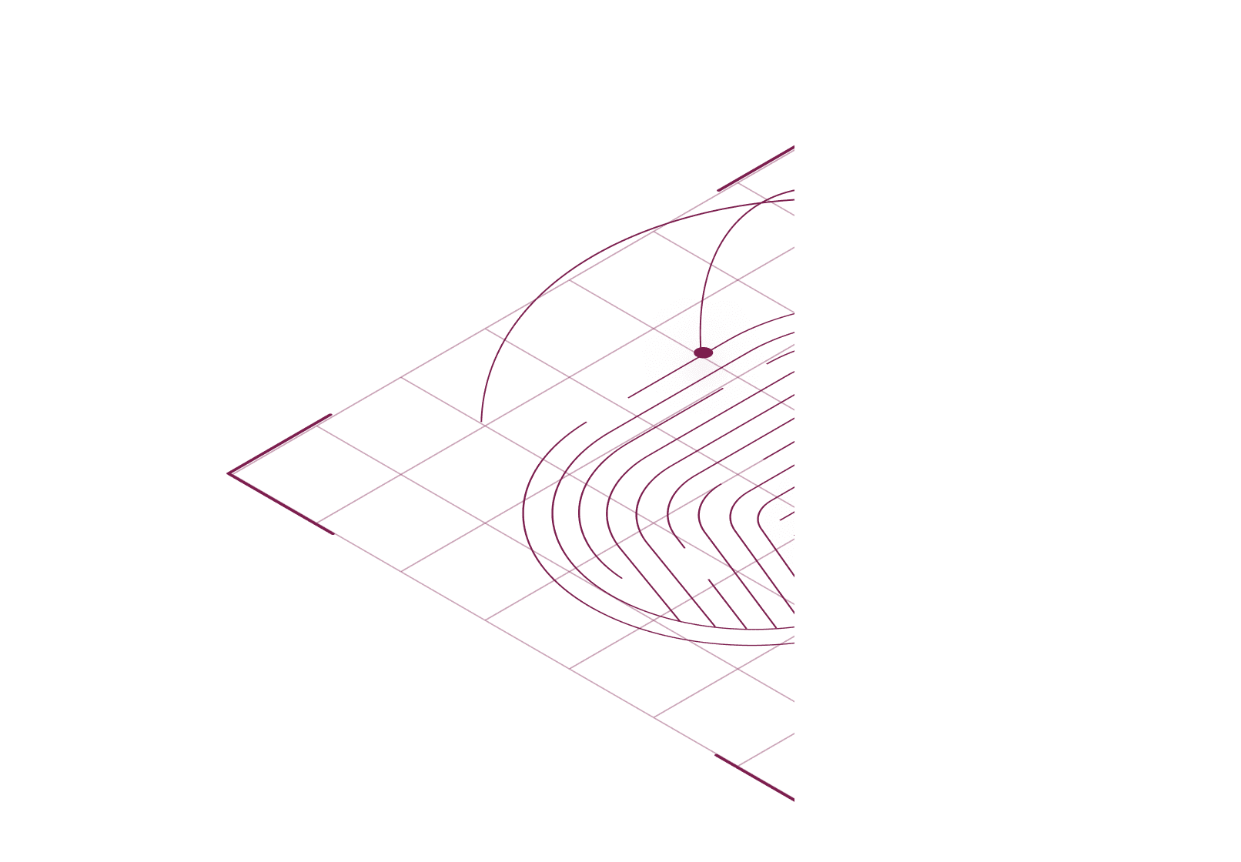











Building Virtual Trust Layers
Ethical Data Governance for Web Companies
January 2022
Richard Whitt | richard@deeperedge.net
© 2022 Deeper Edge LLC All rights reserved.

Slide 2
Governance by Online Companies Is A Mess
Governance = “rules of the road” for distributing power between people.
On the Web, these rules typically are embedded in unilateral, confusing, unread policies.
Web2 (cloud/mobile/social/apps) governance is rife with power asymmetries.
Online companies are driven by SEAM cycles (surveil, extract, analyze, manipulate).
Personal data has become a commodity, fueling pernicious business models.
Mere “users” have no actionable rights, and greatly constrained autonomy/agency.
Policymakers mostly focus on limiting damage, rather than engendering better approaches.
Web3 (blockchain/smart contracts/wallets/NFTs) governance is more of the same.
Web2 fronts to Web3 (Coinbase, OpenSea) act like other online companies.
Web3 promises massive decentralization, by shifting control over personal data to users -- but claims of “trustless trust” too often fall short.

Slide 3
What’s the Solution? Create an Ethics-Based Web Ecosystem
Give forward-leaning online companies a viable alternative to the status quo.
Bring ethical data governance to Web2/Web3, to address entrenched power asymmetries
Utilize a multi-layered, ecosystems approach: business models, technology stacks, governance implements, public policy inputs, end user incentives
All sides benefit:
Mere users become empowered patrons/clients/customers, with legitimate trust and support
Companies become valued and trustworthy intermediaries, making more money from seeding data-rich marketplaces of willing buyers and sellers
Investors profit from more long-term sustainable companies
Policymakers gain an important tool to tackle data privacy, competition, content moderation challenges

Slide 4
How Do We Get There? Build Virtual Trust Layers
A Virtual Trust Layers (VTLs) platform is an open source, business-to-any (B2X) offering, provided as modular inputs to Web companies’ existing operations.
A verifiable vertical stack: (1) codifies top-level ethical principles, (2) instantiates them as entity duties, (3) translates them into external policies, (4) embeds them in internal practices, (5) maps them to consequential data flows, and (6) assesses tangible impact.
A horizontal platform: cuts across network layers, action modules, data lifecycles, and algorithmic decision points.
An open source/open access project: developed, iterated, and provided on fee-free basis.
A standardized system: mixes and matches discrete modules to suit particularized scenarios – from devising agential privacy policies, to designing humanistic interfaces, to applying fiduciary duties to data flows, to analyzing end-to-end networks.
An adaptive engine: powers a variety of use cases, including online presence, mobile, enterprise, smart cities/IoT, Web 3.0/blockchain, and AR/VR/MR “meta” platforms.

Slide 5
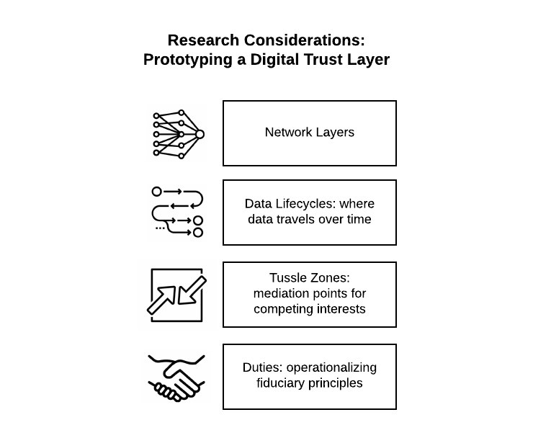
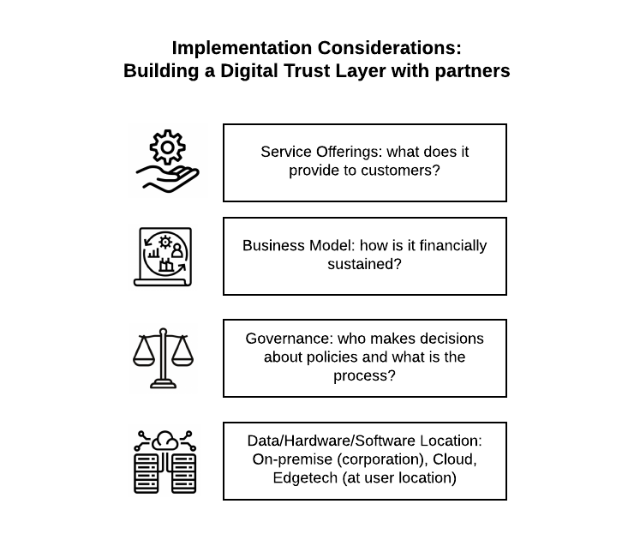
R+D: Virtual Trust Layers Elements
Research Considerations:
Prototyping a Virtual Trust Layer
Implementation Considerations:
Building a Virtual Trust Layer with Partners

Slide 6
VTLs: Stacking Interoperable Modules
Core modules of the VTLs platform include:
Network Stacks: where data packets travel through layers of information systems.
Data Lifecycles: where data resides in servers, routers, algorithms, and applications.
Algorithmic Tussle Zones: recognizing external interfaces (“screens and scenes”), and intra-network mediation points (“unseens”), where competing interests “tussle” for control over data access and analytics decisions.
Duties: defining and fully operationalizing applicable obligations, based on extant laws of fiduciaries, trusts, and/or bailments.

Slide 7
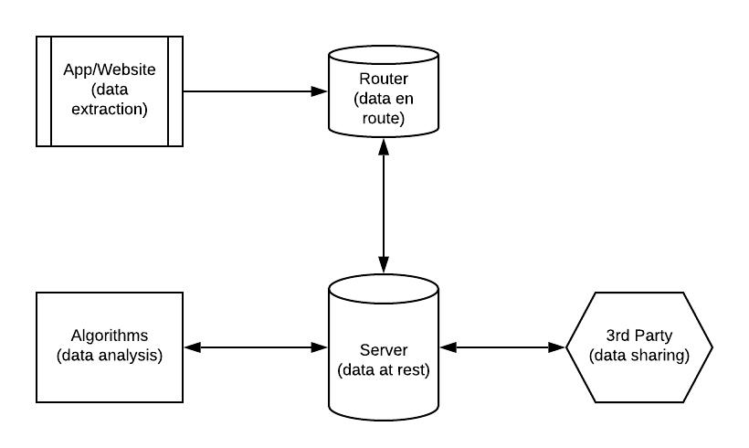
VTLs: Recognizing Data Decision Points
Developing a platform of virtual trust layers involves identifying discrete points in network architecture, where consequential decisions can impact trust-based relationships.

Slide 8
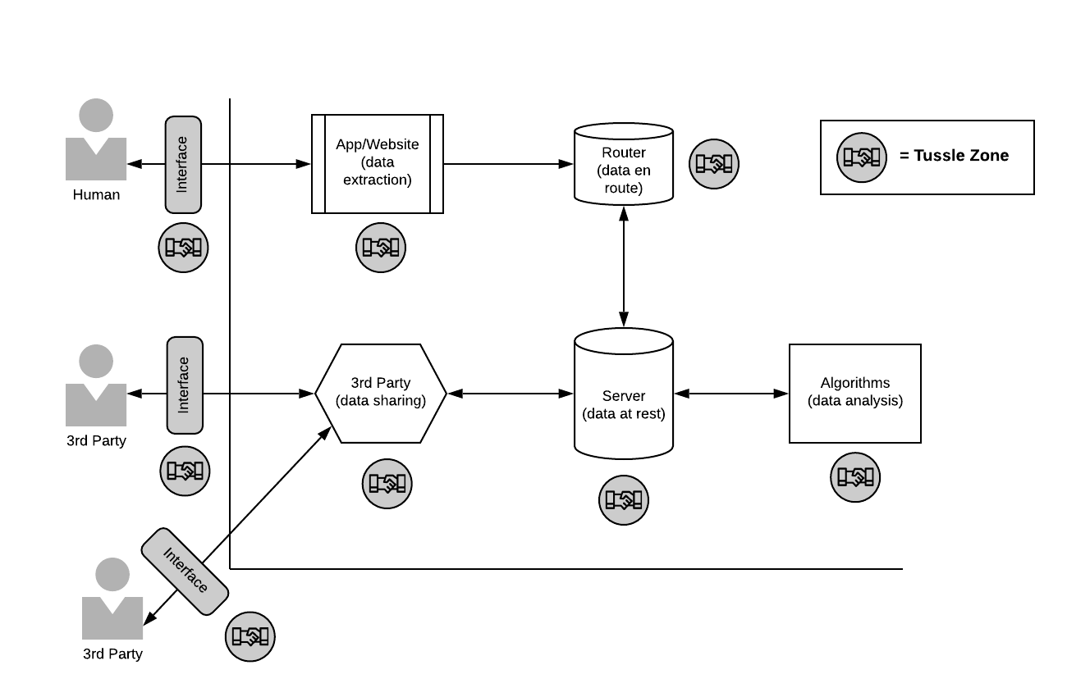
VTLs: Operationalizing Tussle Zones
Within each entity, decision points can include “tussle zones,” where competing interests warrant reviewing/improving data handling and algorithmic practices.

Slide 9
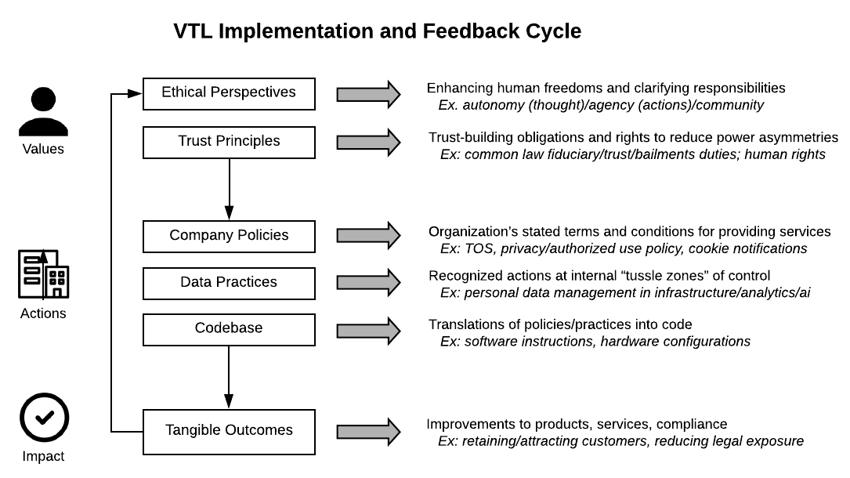
VTLs: A Platform Reference Model
Each VTLs platform provides modular plug-ins, based on core legal and ethical principles.
The toolset can be customized to inform/complement existing systems and policies.

Slide 10

Progress
Fall 2021: Conversations commence with for-profit companies, to assess digital fiduciary roles in VTLs-based ecosystem; notable signups include DataLucent, emortal, and Daxlens.
September 2021: World Economic Forum white paper released, validating VTL-informed processes to empower citizens in the City of Helsinki, Finland.
November 2021: Presentation of VTLs platform to Mozilla Foundation’s Data Futures Lab
December 2021: Discussion groups form to seek feedback on pilots, coalition ideas.

Slide 11
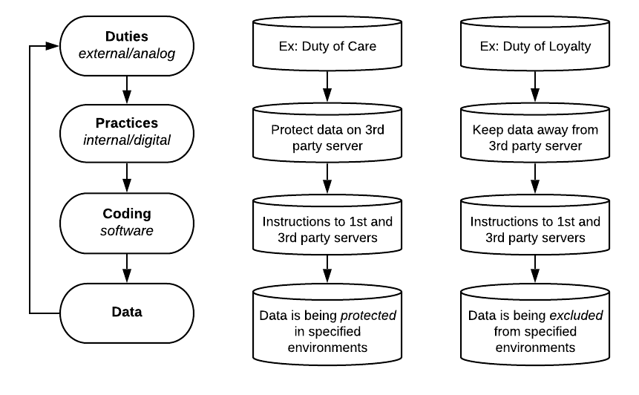
VTLs: Fiduciary Engine
A VTLs platform can power a “Fiduciary Engine,” where strong ethical foundations are embedded within common law-based obligations, such as fiduciary duties of care and loyalty.

Slide 12

















Use Case: Agential Human as Focal Point of Fiduciary Engine
This prototype schematic shows how an entity can serve as a digital fiduciary, using a VTLs platform configured as a Fiduciary Engine.
In this scenario, the VTLs ensure that a company’s offerings bolster an individual’s personal data ecosystem, in full compliance with fiduciary duties of care and loyalty.
Authorization Manager
Access Gateway from/to Individual
Relationship Manager
Personal Data Repository
Digital Fiduciary
Individual
Identity Manager
Personal AI
HUMAN
Edge
Web

Slide 13
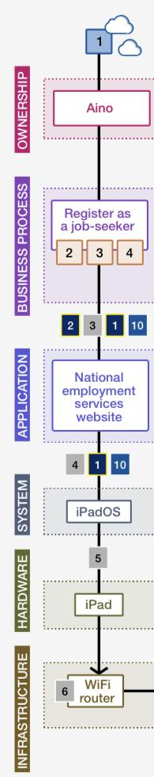
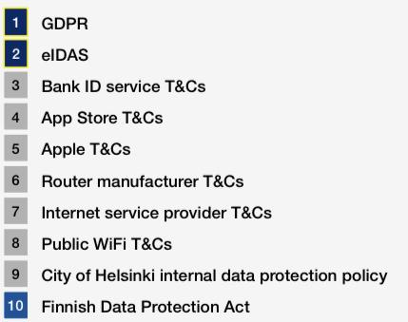
Use Case: Digital City of Helsinki, Finland
September 2021: A World Economic Forum initiative developed a VTLs-informed framework to govern the City of Helsinki, grounded in data lifecycles, network layers, and “tussle zones.”

Slide 14
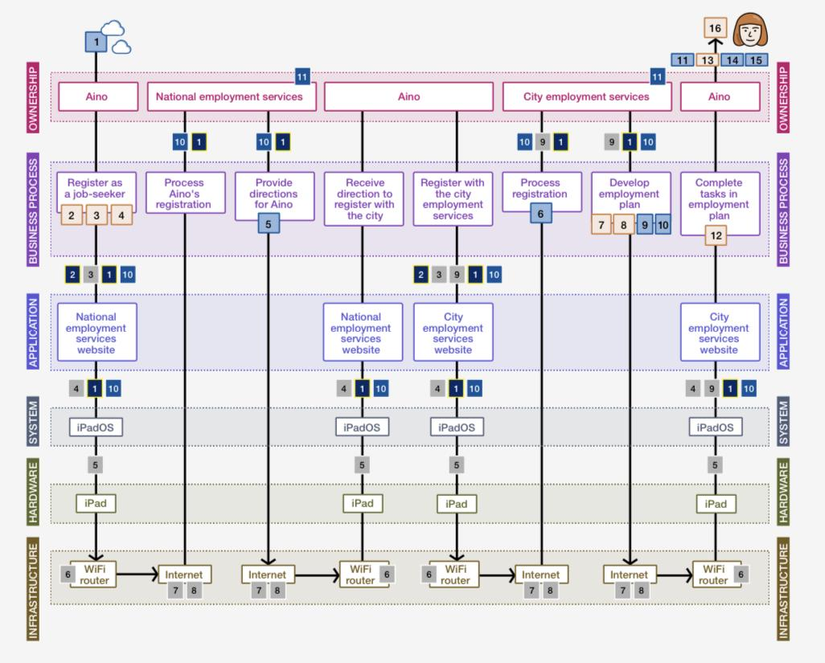
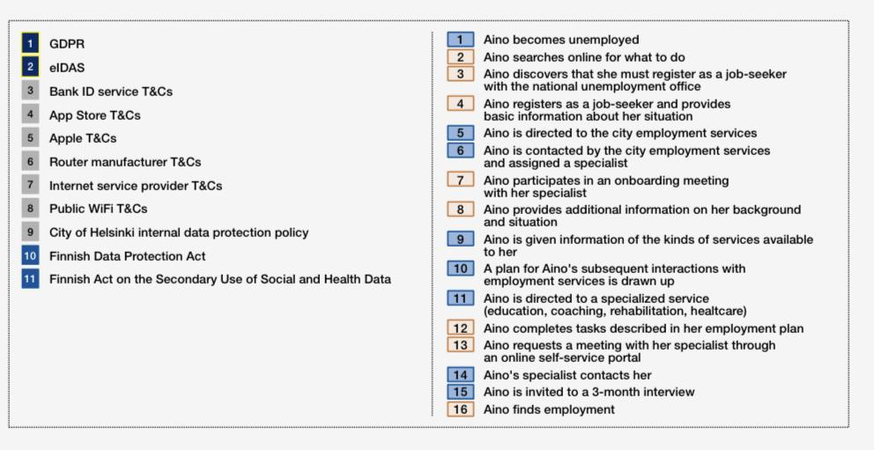
Aino’s Data: A Day in the Life of a Helsinki Citizen

Slide 15
Mapping a City’s Human/Tech Governance Touchpoints

Slide 16
Additional Use Cases
Web2 companies – crafting fiduciary terms of service/engagement
Web3 DOAs/DApps – placing humans in the loop of “trustless trust” arrangements
Mobile apps -- setting user privacy policies
Enterprise companies – establishing dual authorized use policies
Smart cities governance – promoting terms of citizen interactions with IoT environments
Transborder data – assessing bailment-type duties to global flows of data
Metaverse platforms – developing novel multidimensional governance ethos

Slide 17
VTLs Platform Roadmap: Key Ecosystem Components
Dependencies: identifying “legal hacking” opportunities (exploitable mechanisms in laws/regulations/policies) and market barriers (such as lack of uniform platform interoperability, data portability, and authorized agent delegation).
Accountabilities: deriving potential mechanisms of accountability and enforcement, from governmental laws and regulations, to standards, certifications, best practices, and codes of conduct.
Landscape Census: cataloging full array of decentralized Web2/Web3 technologies, and their implementing B2C/B2B entities that could benefit from VTLs platforms.
Digital Stewards Alliance: forming coalition of like-minded entities, acting collaboratively as multi-stakeholders to serve in a variety of capacities to steer new Web paradigm.
Public Policy Agenda: advocating for government laws and policies that would transform commercial dependencies into policy inputs

Slide 18
Assembling a VTLs-Based “Digital Stewards Alliance”
A cross-functional coalition can help bring to life an ethical Web ecosystem, utilizing the VTLs platform as a governance tool. Roles can include:
Technology Testbeds
Open-Source Contributors
Governance Collaborations
Commercial Partnerships
Policy Advocates
Ecosystem Funders

Slide 19
Core Partners: GLIA Foundation, Deeper Edge LLC
GLIA Foundation (non-profit)
Developing the VTLs platform as an open source/access tool
Assembling various ecosystem components
Convening stakeholder coalition
Certifying compliance
Deeper Edge LLC (for-profit)
Providing strategic counsel
Facilitating commercial collaborations
Customizing VTLs fit for case-by-case scenarios
Offering collateral products and services

Slide 20
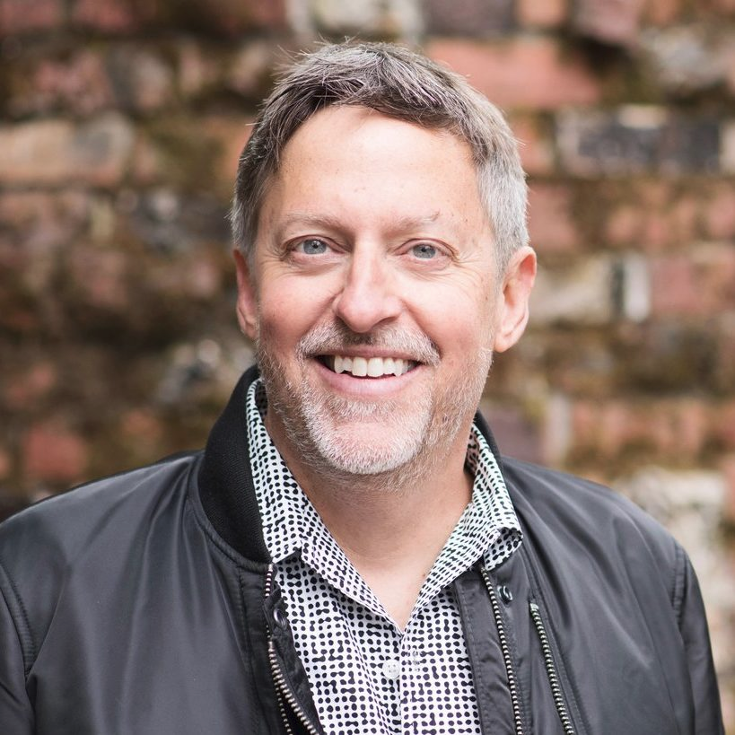
Richard Whitt
Expertise
Corporate strategist
Tech policy attorney
Data governance expert
Current Roles
President of GLIA Foundation
Founder of Deeper Edge LLC
Fellow with Georgetown U. Tech Law Institute
Formal advisor to, and investor in, Web2/Web3 startups
Prior Experience
Thirty-plus years in Internet policy, legal, and strategy
Former longtime (11+ years) Googler (corporate director for strategic initiatives)
Former Mozilla Foundation fellow in residence (3+ years)

Slide 21

Thank you!
info@deeperedge.net
deeperedge.net
glia.net

